Slide 1
Global Terrorism Database
Philip Bradfield
January 19, 2017

Slide 2
Agenda:
Bayesian analysis of UK and France - Terror Related Bombings (TRB)
‘9-11’ a ‘spurious’ data point.
Missing 1993 data - USA deaths due to terror (Domestic & World Wide)
Bonus

Slide 3
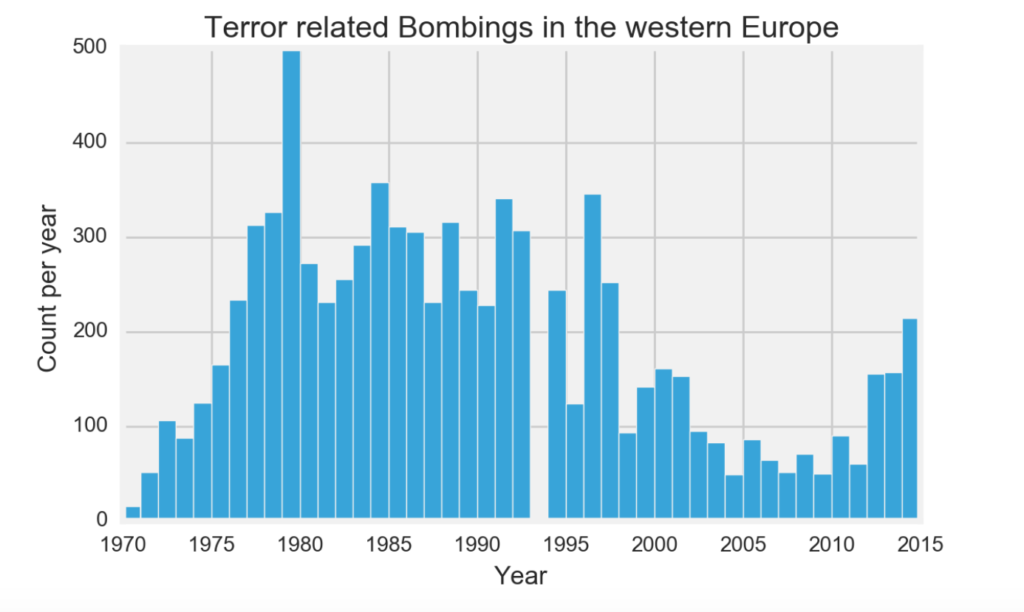
Western Europe - Terror related Bombings
Bayesian posterior estimation - difference in France & UK

Slide 4
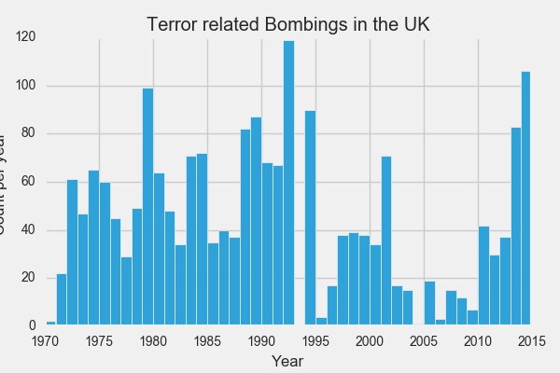
UK - Terror related Bombings

Slide 5
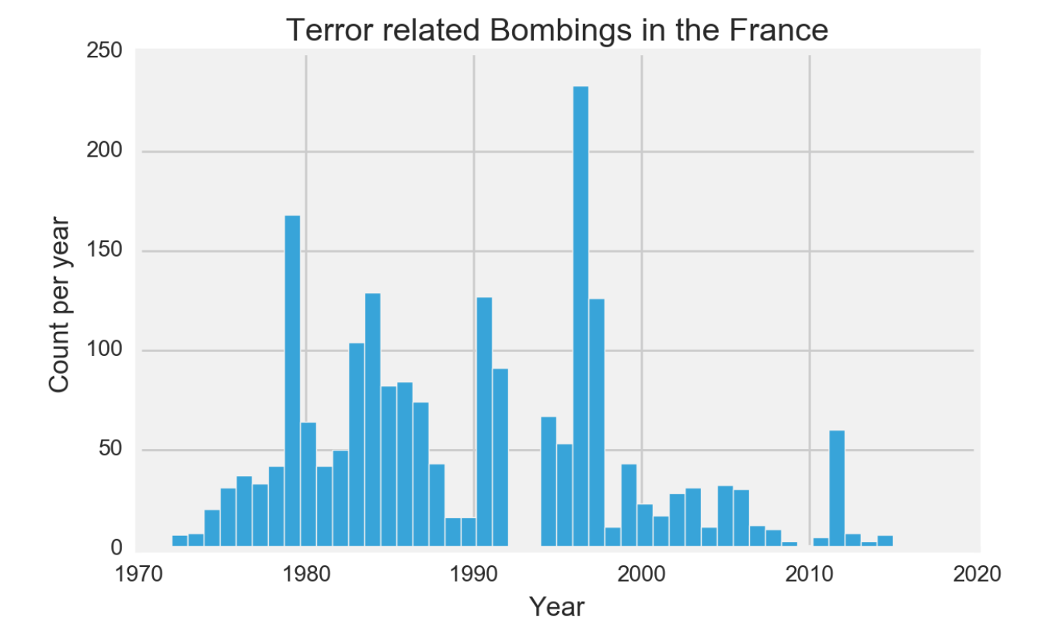
France - Terror related Bombings

Slide 6
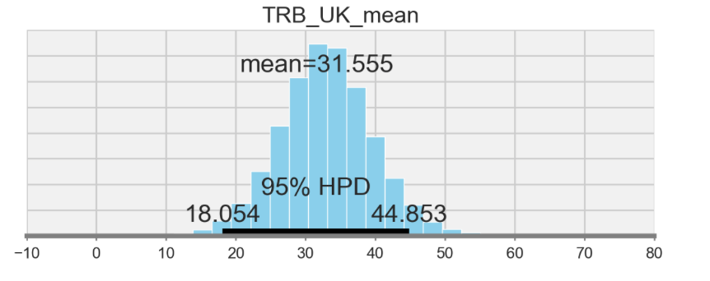
UK - Terror related Bombings - mean

Slide 7
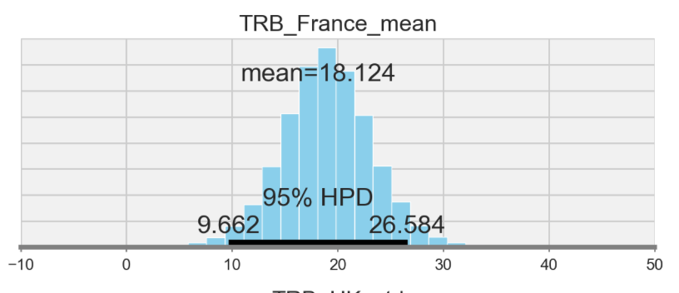
France - Terror related Bombings - mean

Slide 8
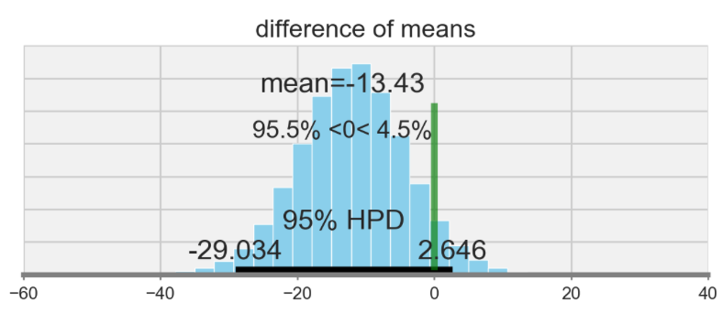
Difference of means of UK and France

Slide 9
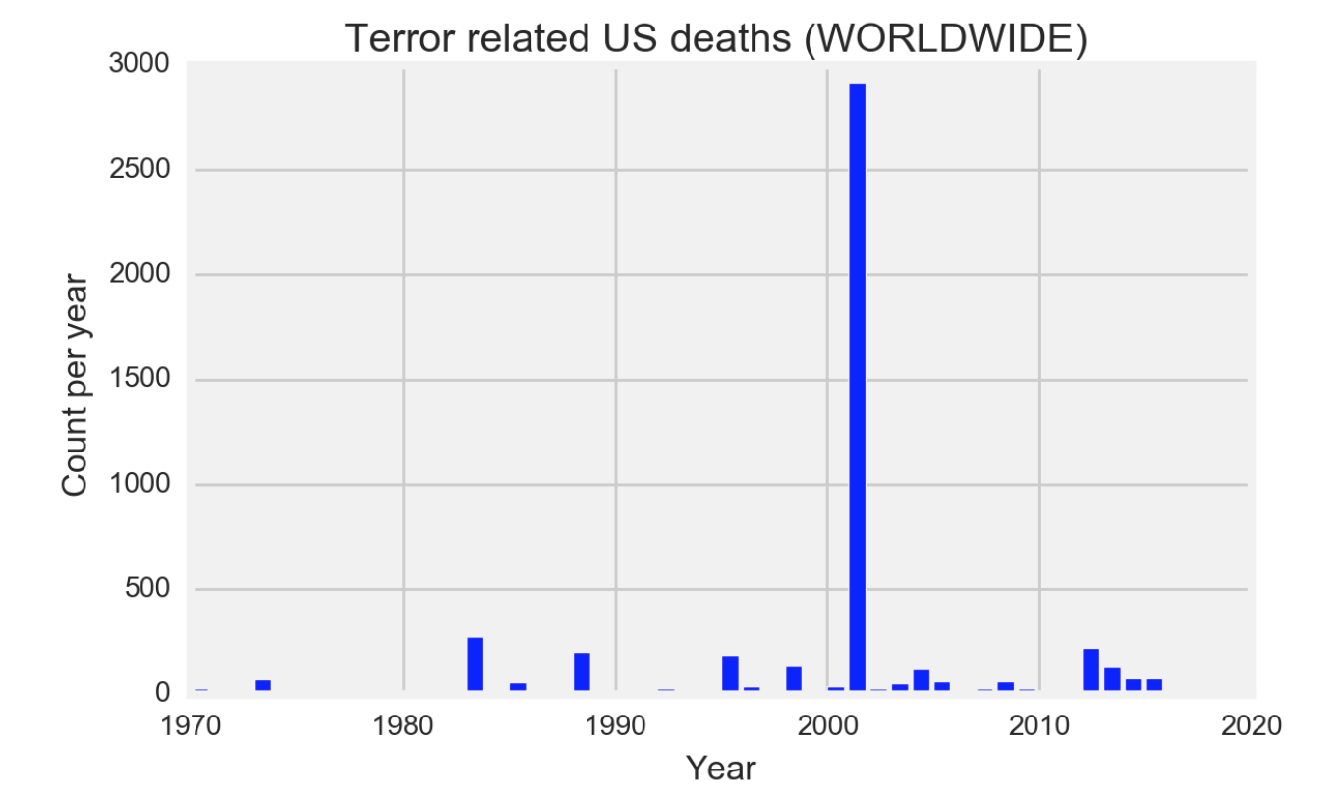
USA - Terror related deaths - World Wide

Slide 10
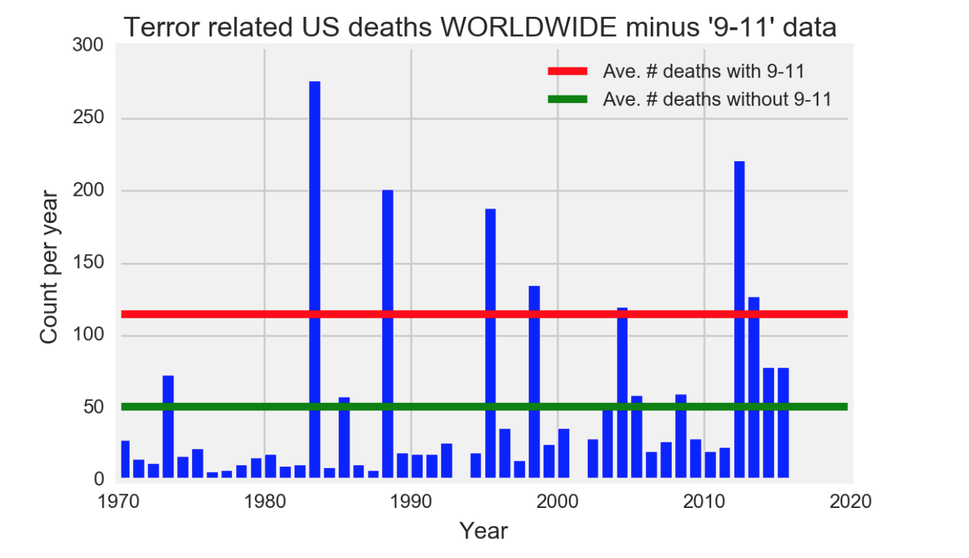
USA Terror related deaths - World Wide

Slide 11
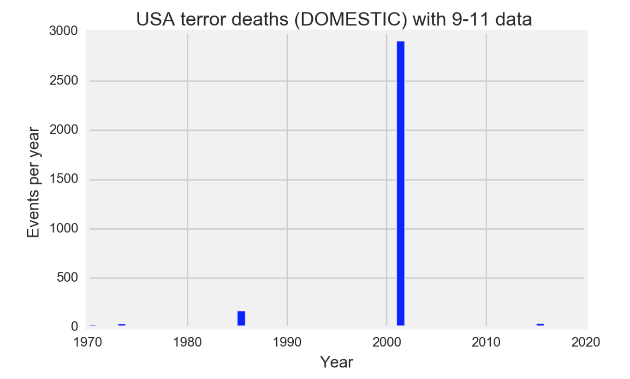
USA Terror related deaths - Domestic -
with 9-11 data

Slide 12
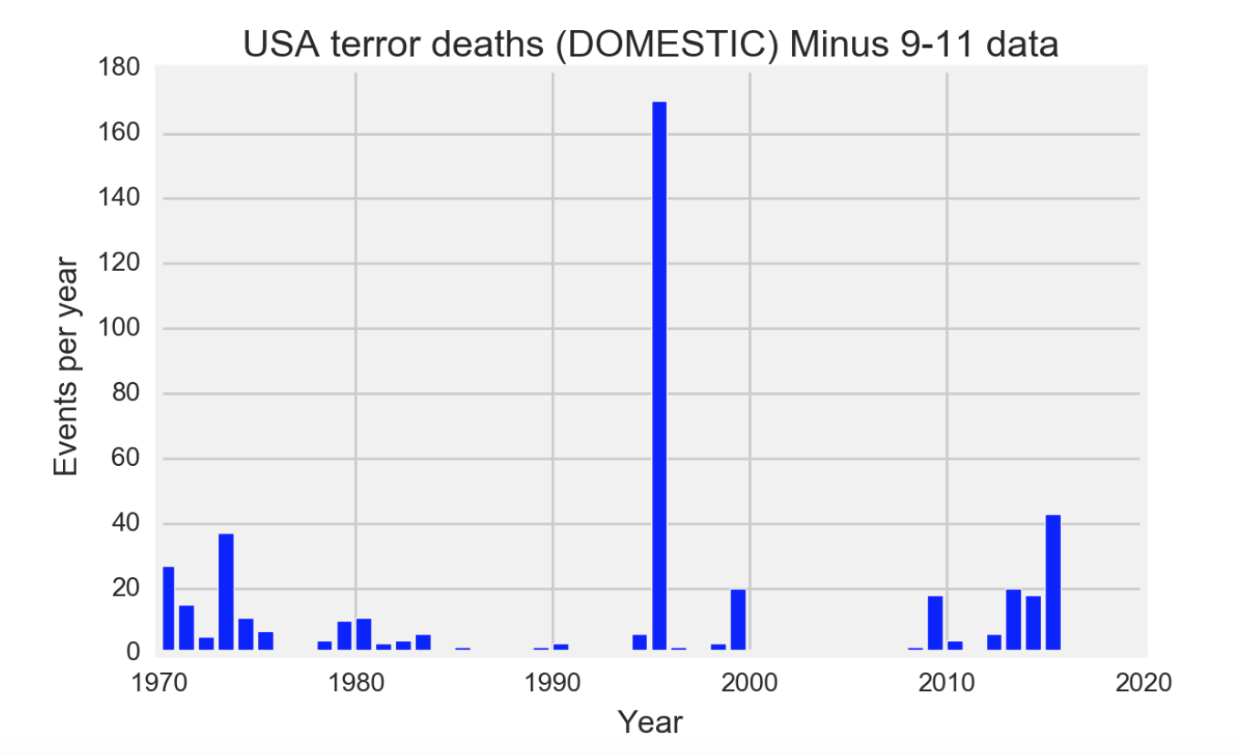
USA Terror deaths domestic - minus 9-11

Slide 13
1993 - Missing Data -
USA terror deaths (not including 9-11)
World Wide - Mean - ~ 51 deaths
Interpolating - (average of 1992 and 1994) - 23.5 deaths
From the GTD (See the appendix) - 21 deaths
Domestic - Mean - ~ 10 deaths
Interpolating -(average of 1992 and 1994) - 3 deaths
From Wikipedia - 9 deaths

Slide 14
Bonus: math wording suggestion for clarity...
Someone tells you that they had a million dollars and they now have increased that by 300%.
Quickly, tell me how much do they have?

Slide 15
Answer
The answer is four million dollars.
The point is this. Once you have gone beyond a 100% increase (a doubling) don’t use percentages. Use multiplication. Ex.. three times as much. Most people can quickly understand multiplying by a simple number. Using “three hundred percent increase” will make many, if not most, people think three times as much when it is four times as much.

